Slide 1
Parallel and Distributed Computing(CSE4001)
Project Review 2
Improvisation of Convays Game Of life
(Fall 2020-21)
Team members:
Kaustubh Jha (18bce1043)
Taksali anjali (18bce1254)
Vivek gorania (18bce1310)

Slide 2
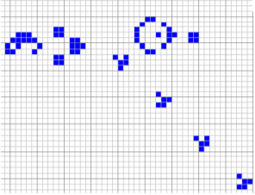
INTRODUCTION :
The goal of our project is to design a visualization of the Game of Life as described by John Horton Conway.1 The Game of Life is meant to show what happens to organisms when they are placed in close proximity to each other.
The Game of Life is not really a game, but more of an algorithm used in Cellular automation and many processors which helps in parallel processing.
Application of Cellular Automata
Computer processors
Error correction codes
Mathematical Computation

Slide 3
Project implementation
Languages used:
P5 framework of javascript for parallel processing and animation.
Html,Css for Front-End.
Openmp for parallel execution

Slide 4
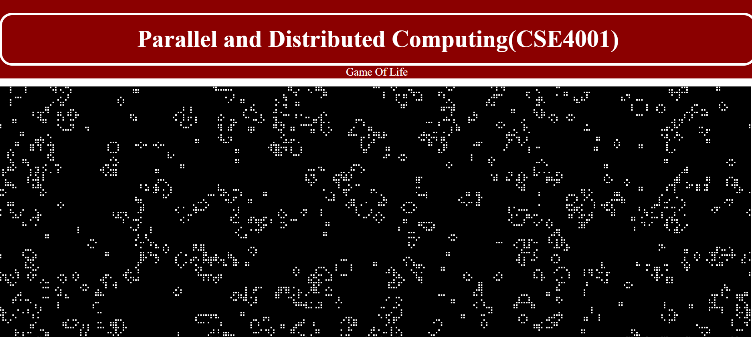
Project implementation(Front-End)

Slide 5
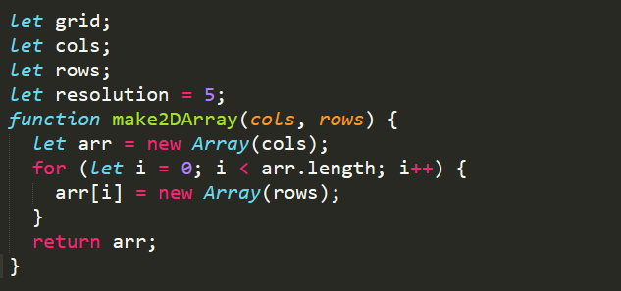
Code Execution
For creating 2D array

Slide 6
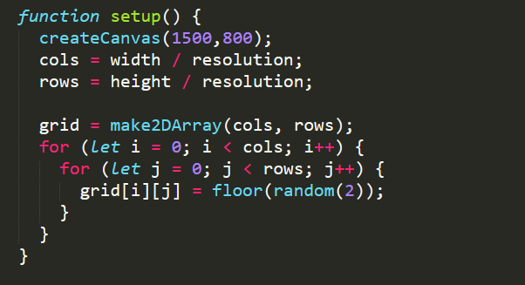
For setting size of each cell and it’s random value(dead or live)

Slide 7
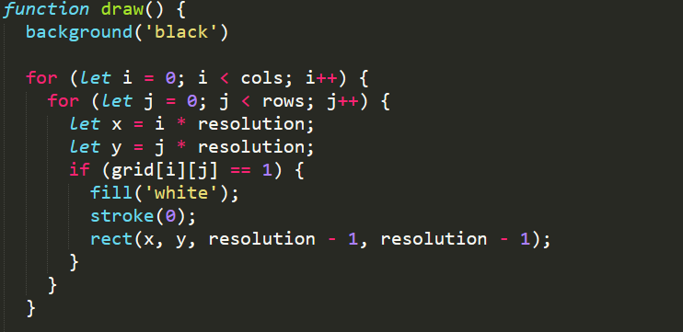
For background and cell effect

Slide 8
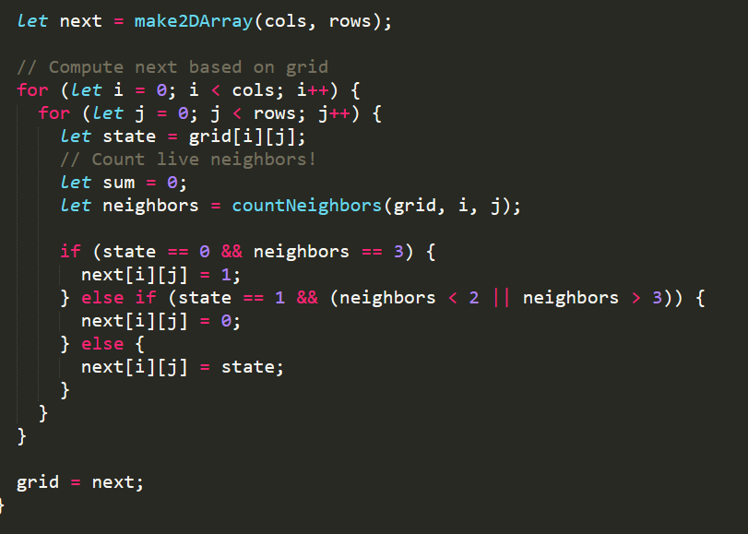
Parallel processing for finding next state of all cells at same time

Slide 9
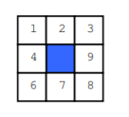
Rules To Play Game
The rules of the game are simple, and describe the evolution of the grid:
◮ Birth: a cell that is dead at time t will be alive at time t + 1 if exactly 3 of its eight neighbors were alive at time t.
◮ Death: a cell can die by:
◮ Overcrowding: if a cell is alive at time t + 1 and 4 or more of its neighbors are also alive at time t, the cell will be dead at time t + 1.
◮ Exposure: If a live cell at time t has only 1 live neighbor or no live neighbors, it will be dead at time t + 1.
◮ Survival: a cell survives from time t to time t + 1 if and only if 2 or 3 of its neighbors are alive at time t.

Slide 10
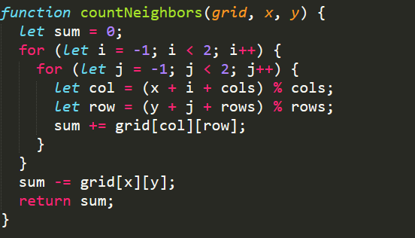
Returning number of live neighbours

Slide 11
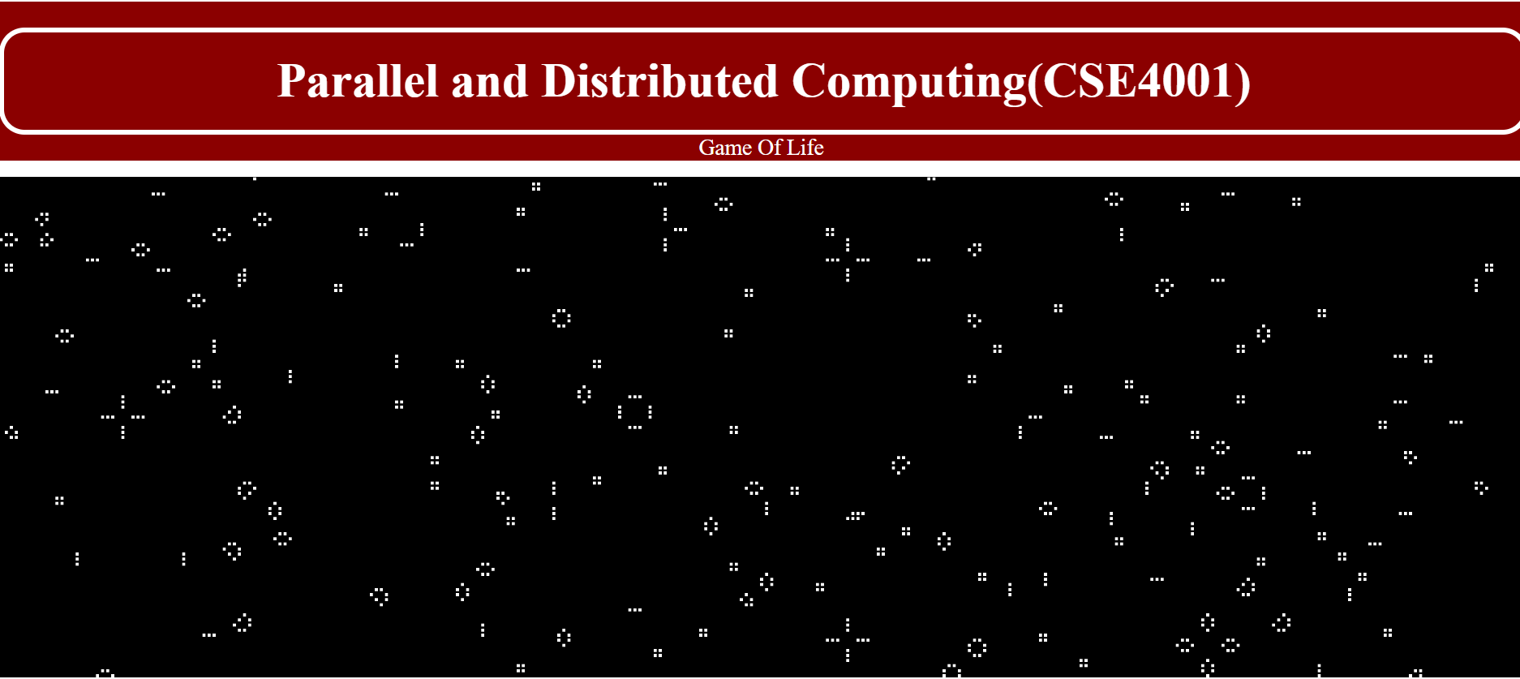
Output
(all cells are in stable state)

Slide 12
Project contribution
we all have worked together on project implementation on google meet.
Anjali : Front-end + openmp implementation in c.
Kaustubh,Vivek : worked with Back-End (Javascript) part + openmp implementation in c.
Although we all have equal knowledge about our project’s working.

Slide 13
Thank You

